Slide 1
CONNECTTEL CUSTOMER CHURN PREDICTION
Presented by: Nehemma juma

Slide 2

Problem Statement
In the highly competitive telecom industry, customers have a wide range of options for their communication and internet needs. Their loyalty often hinges on a single experience, making service quality critical. A brief 30-minute maintenance break can trigger anxiety, revealing how essential these services have become in daily life. With the high cost of acquiring new customers, analyzing churn rates the percentage of customers who cancel or fail to renew their subscriptions is vital.
A higher churn rate directly impacts revenue, as more customers leave the business. By conducting churn analysis, companies can gain valuable insights to develop strategies, target specific segments, and enhance service quality. These improvements foster customer trust and satisfaction. Predictive models and comprehensive churn analysis reports are essential tools for driving growth in this competitive landscape.

Slide 3

Deep-dive Data Analysis

Slide 4

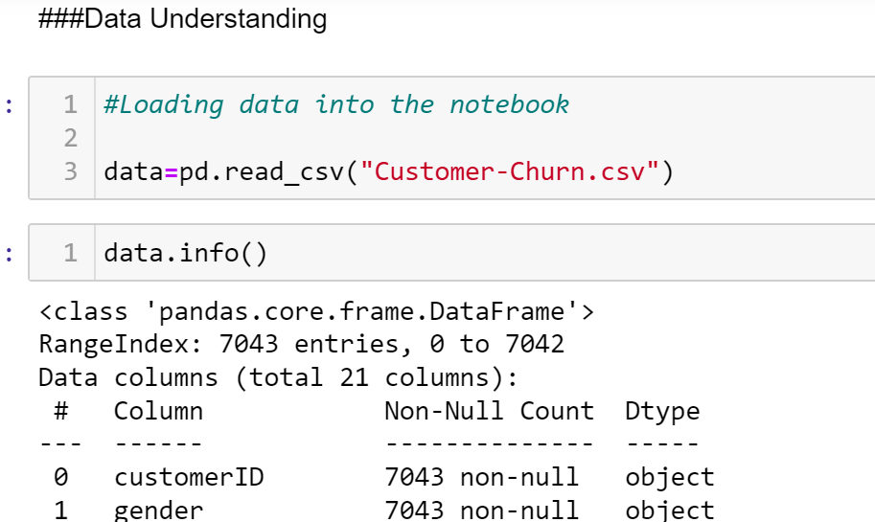
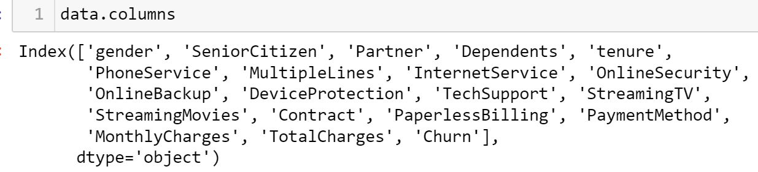
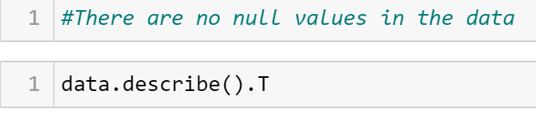
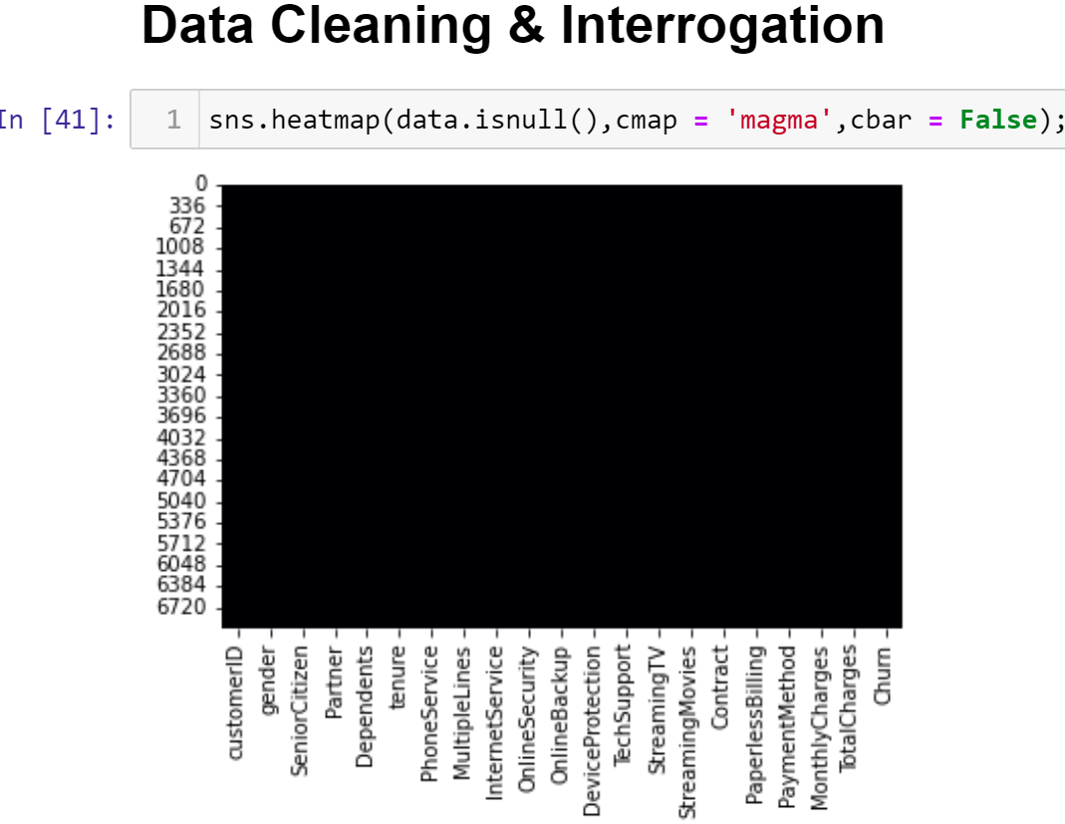
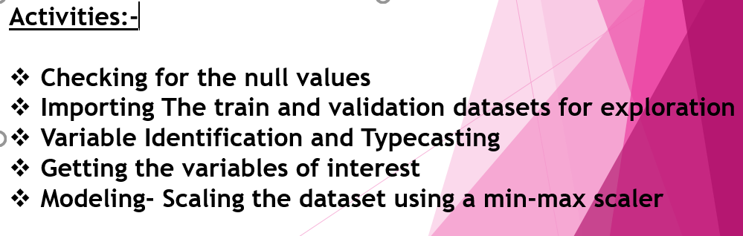
Methodology-Data Cleaning, Exploratory Data Analysis Modelling

Slide 5
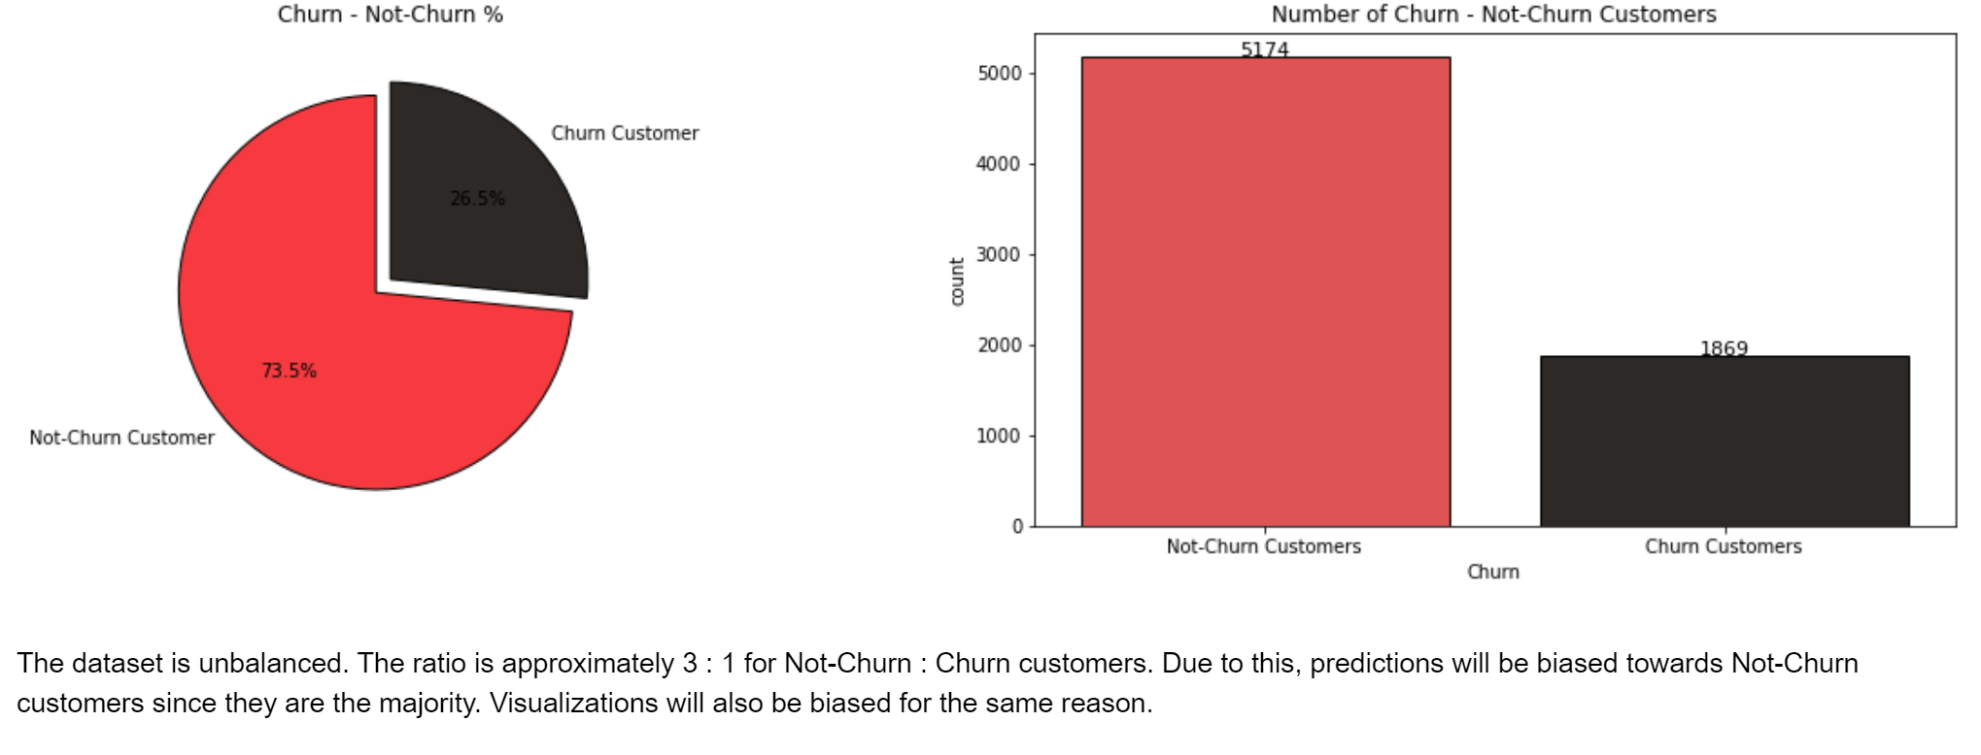
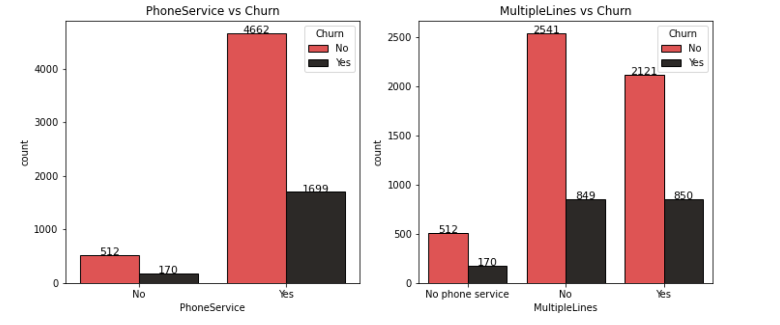
Exploratory Data Analysis (EDA)

Slide 6
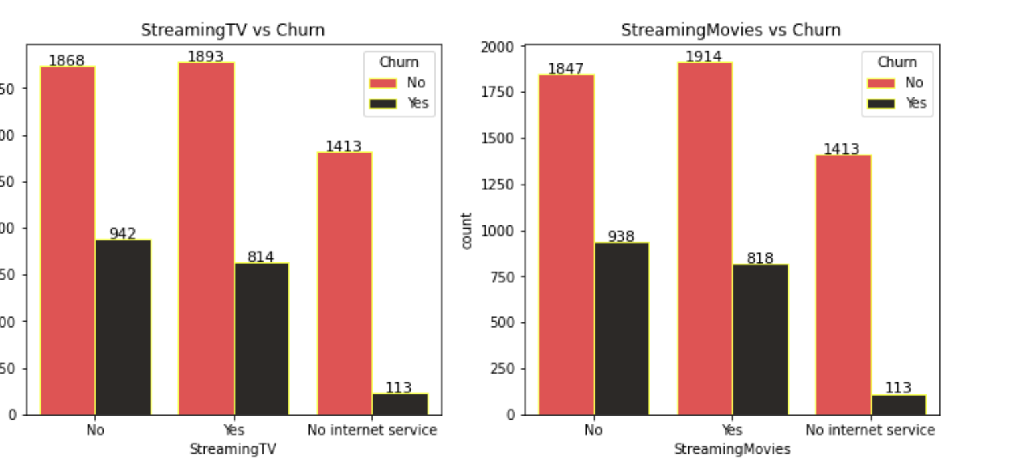
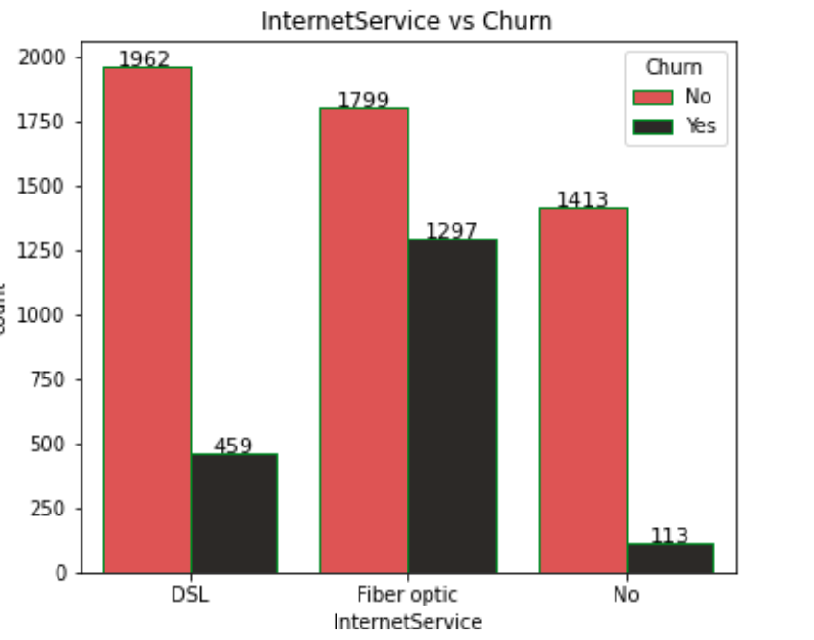
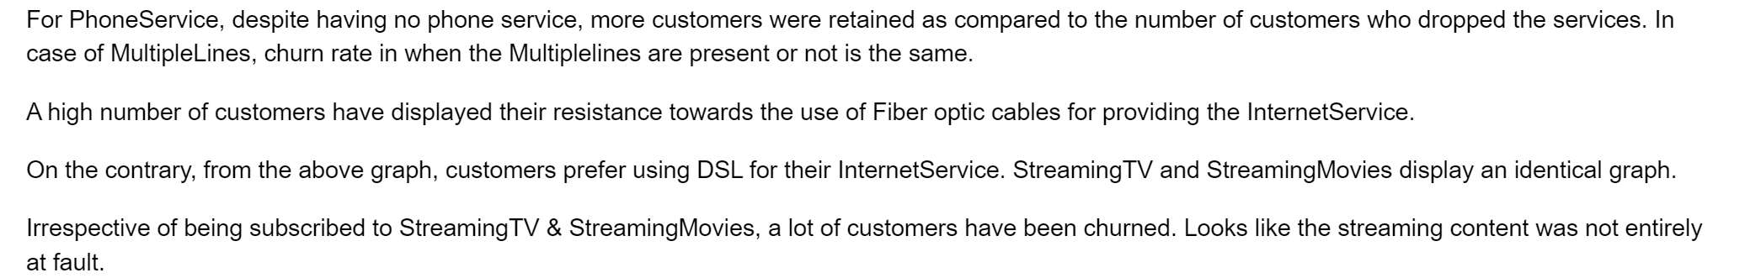
EAD……

Slide 7

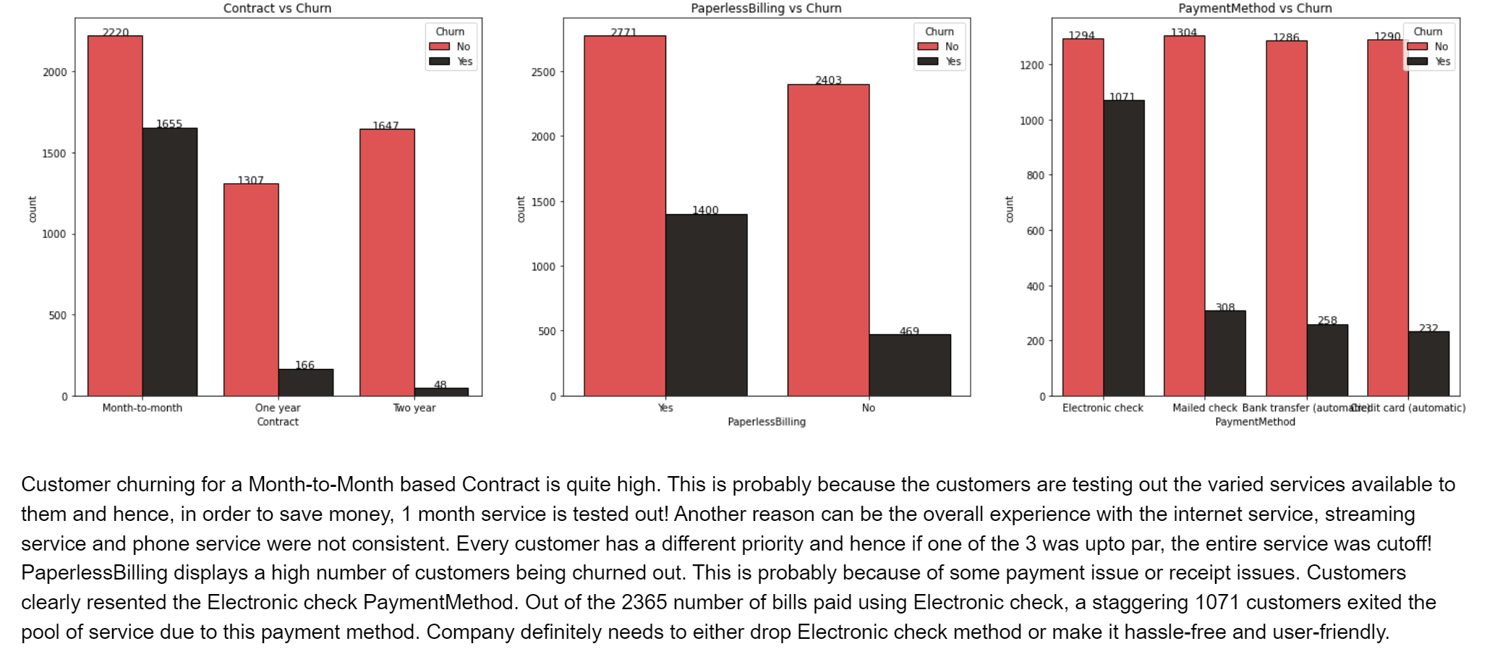
EAD Cont…..

Slide 8
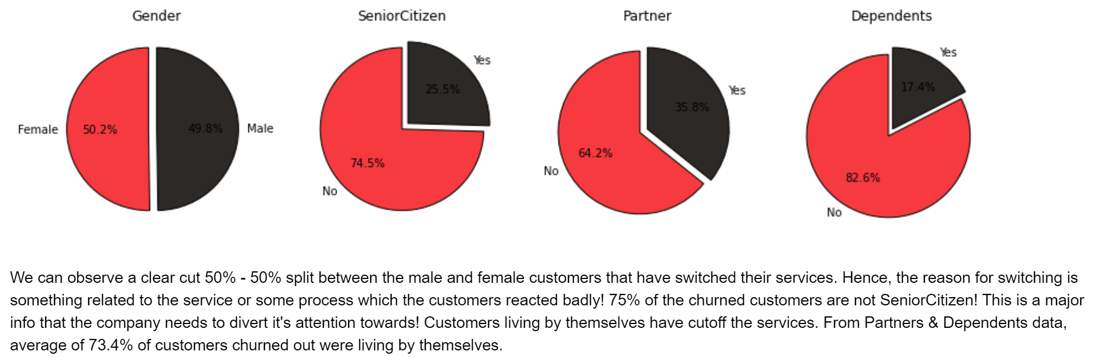
EAD Cont….

Slide 9
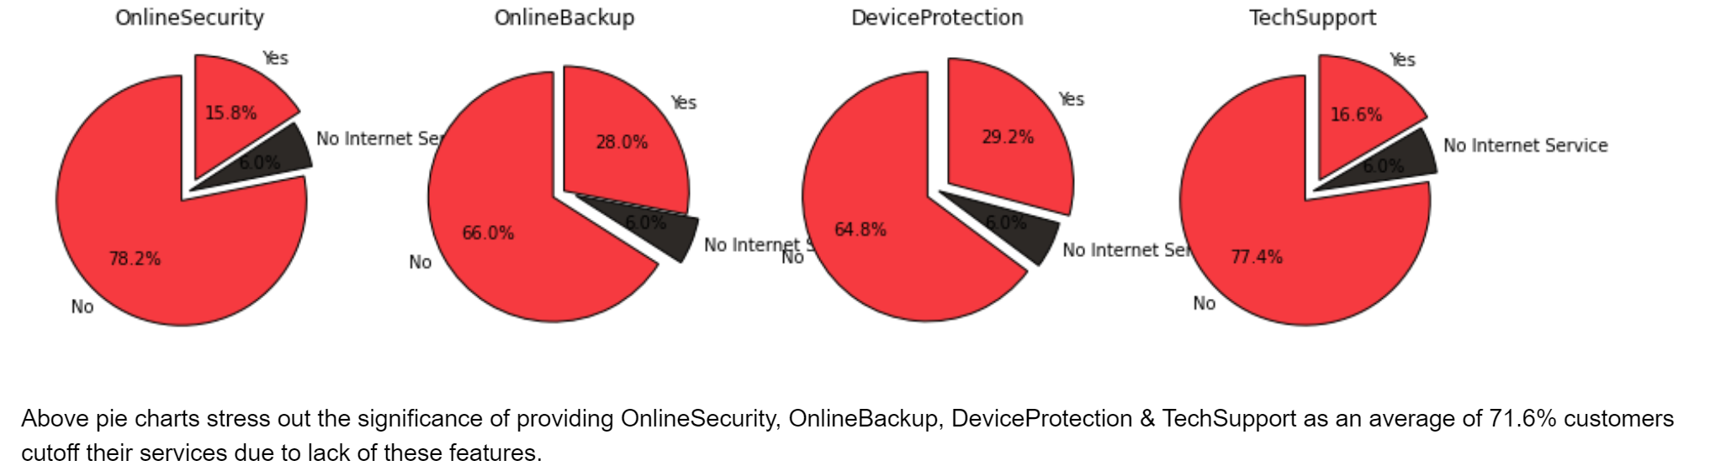
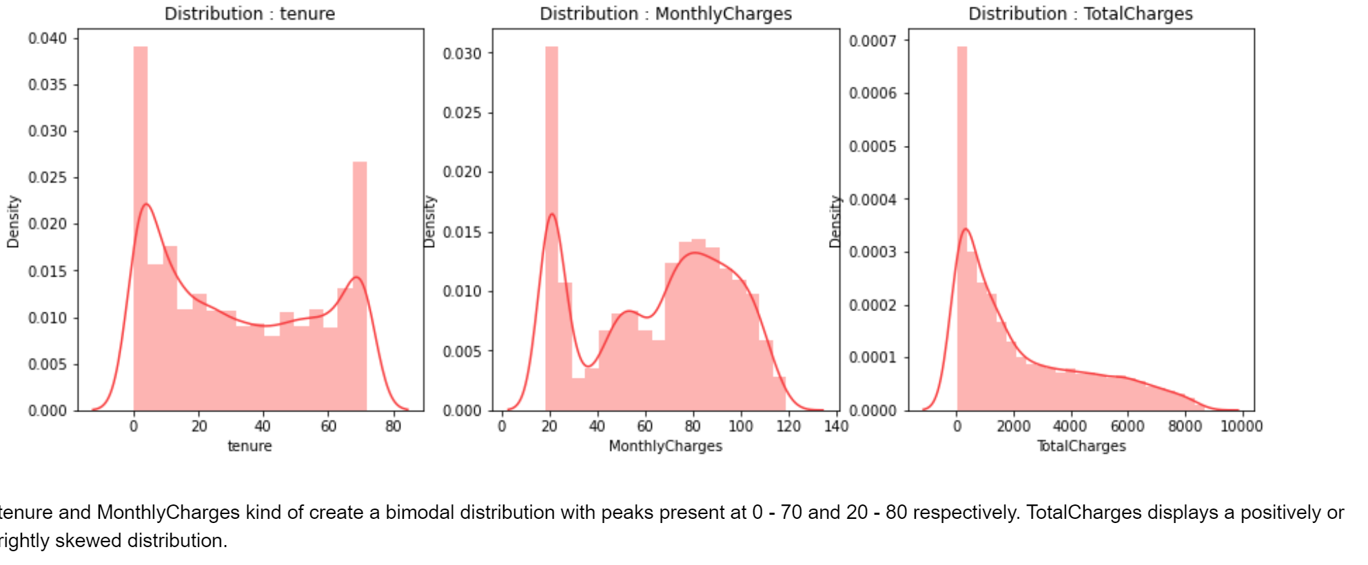
EAD Cont…

Slide 10
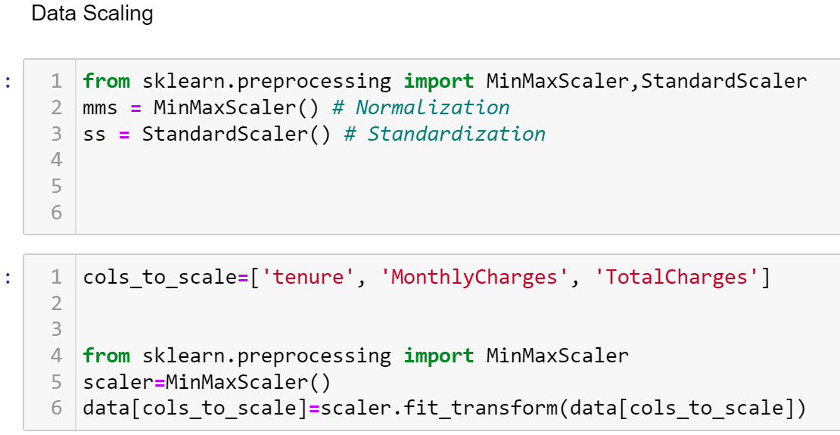
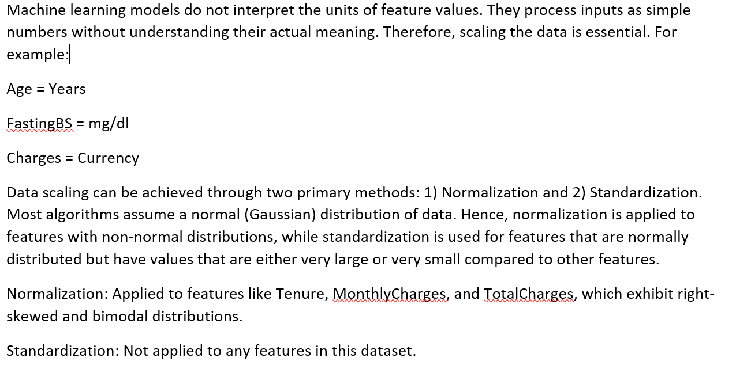
Feature Engineering

Slide 11
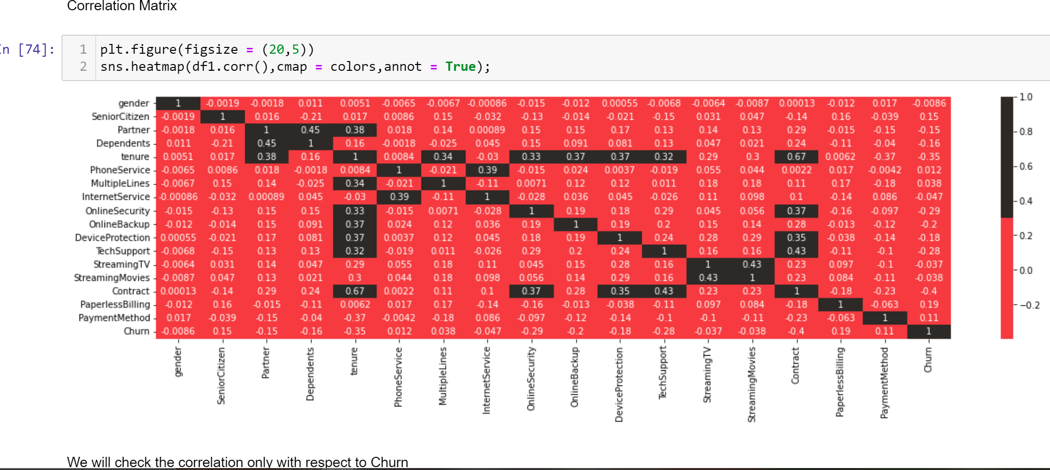
Feature Eng. Cont….

Slide 12
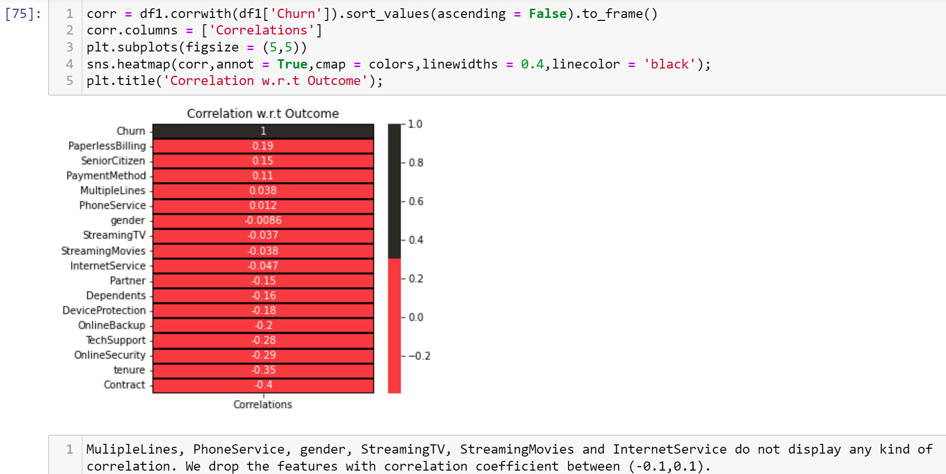
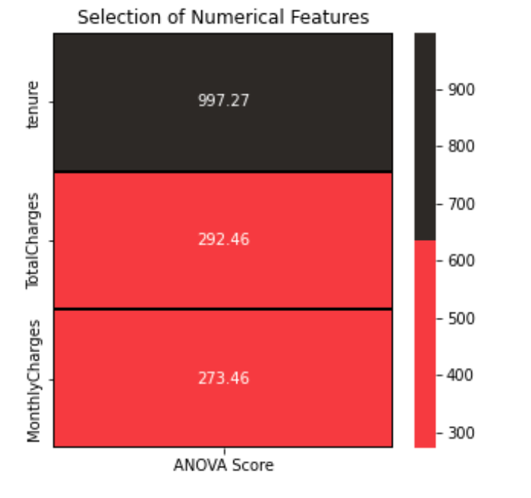
Correlation on churn
ANOVA Test :

Slide 13
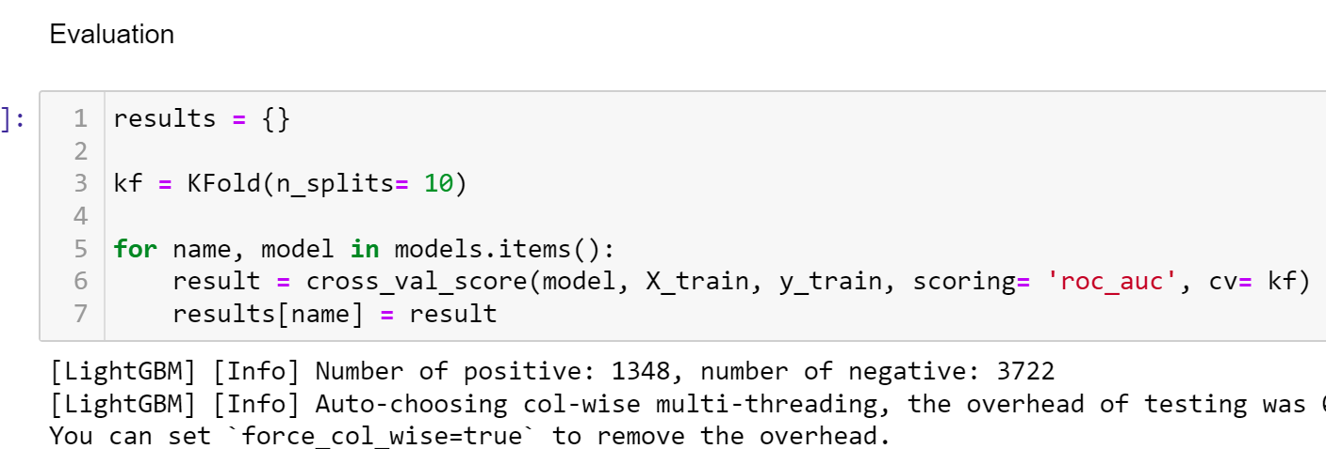
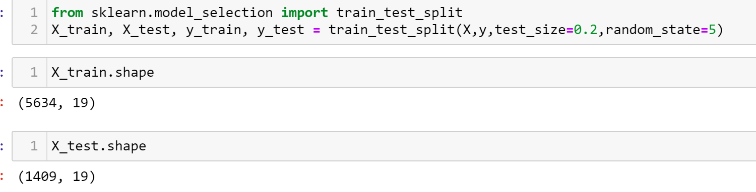
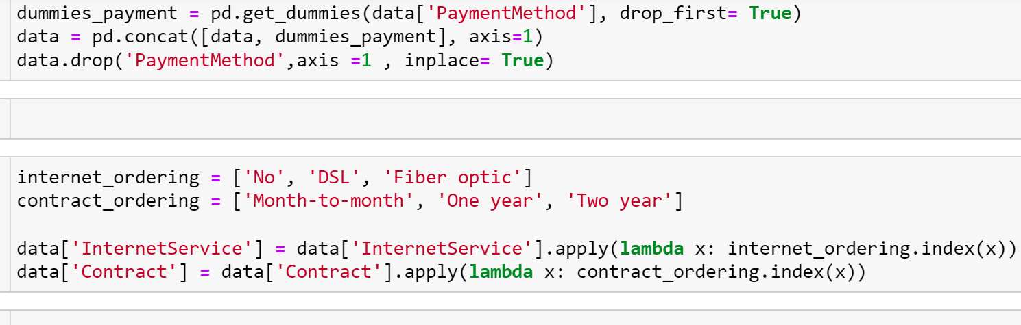
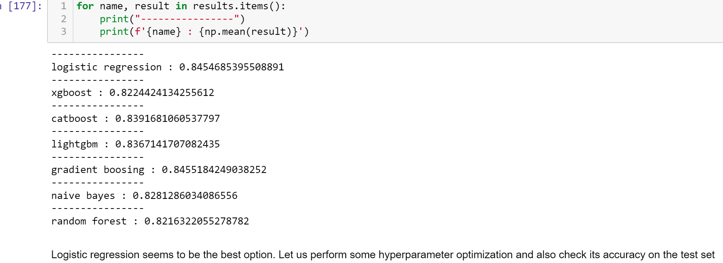
Modeling

Slide 14

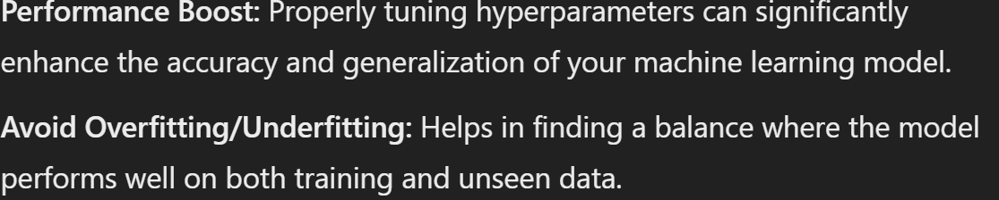
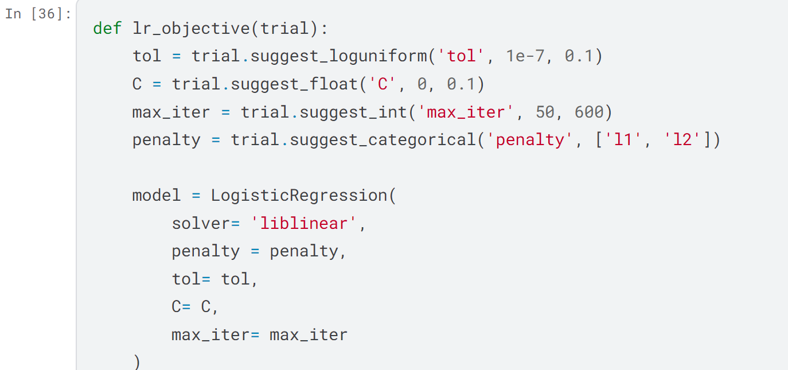
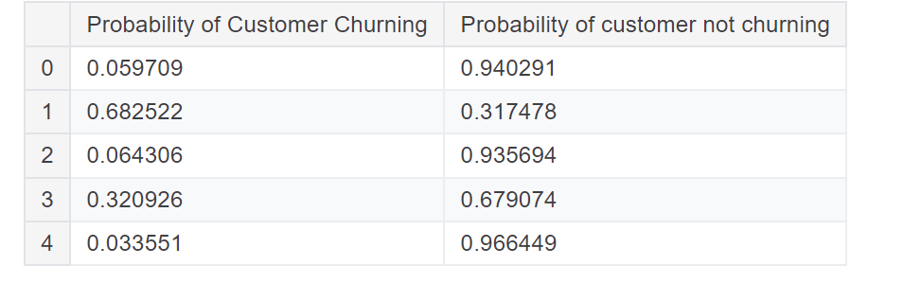
Hyper-parameter Optimization

Slide 15
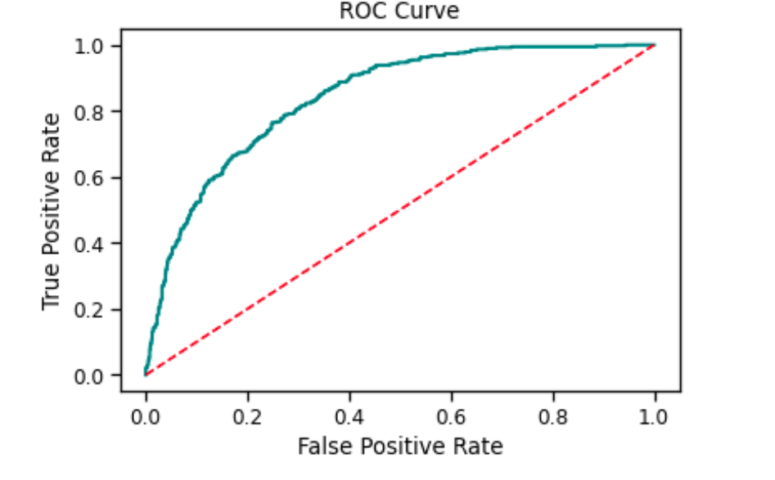
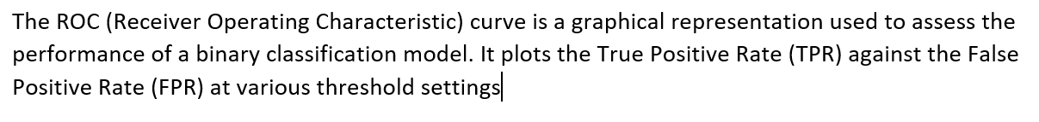
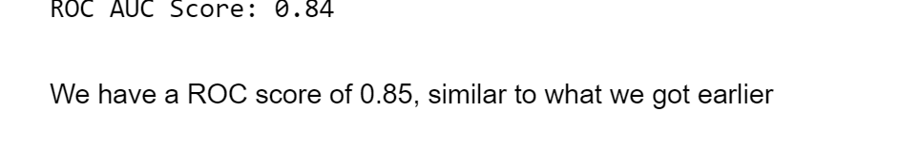
Analysis Cont….

Slide 16
Measures for Reducing Customer Churn & Revenue Increase
The number of Senior Citizen customers are low but their lower limit of Monthly Charges is higher than the other customers. Thus, Senior Citizen customers are ready to pay top dollar but they need to catered with that level of service. For customers with a Partner as well as customers living alone, they prefer services with Monthly Charges below 65.
In order to create a strong foundation of customers, Telco Company needs to create an easy and affordable entry point for their services. For the tenure of 1st 6 months, it needs to focus extensively on Online Security, Online Backup, Device Protection & Tech Support as this period is the most critical and uncertain for the customers. They must lower the churn tenure of 40 - 50 months for these services!.
Once they build a solid pipeline of support services for customers, they need to push the usage of MultipleLines & Fiber Optic cables for the Phone Service & Internet Service respectively. But the major hurdle for these 2 services is the starting point of 75+ in Monthly Charges.
Thus, they need to create combinations of options provided for PhoneService & InternetService where average of these MonthlyCharges will be in the range of 100 - 120 :

Slide 17
Conclusion
Insights gained from the EDA are very valuable for understanding the effectiveness of the existing systems that are in place. They also assist in drawing up plans & measures to counter the problems or be in an infinite loop for improvement.
On model performance, feature creation by combining features was carried out however, they did not outperform the current models.
Hyperparamter tuning & outlier detected could also bump up the F1 Score (Churn) & Cross Validation Score. Stack of models pipped the XGBClassifier & LGBMClassifier by a margin of 0.01 for F1 Score (Churn).

Slide 18
References
https://www.zendesk.com/in/blog/customer-churn-rate/#georedirect
https://www.profitwell.com/customer-churn/churn-prevention

Slide 19

THANK YOU!

